Slide 1


Introduction to Operating Systems CS 1550
Spring 2023
Sherif Khattab
ksm73@pitt.edu
(Some slides are from Silberschatz, Galvin and Gagne ©2013)

Slide 2
Announcements
Upcoming deadlines:
Homework 10: due on 4/11
Project 3: due on 4/11
Lab 4: due on 4/15

Slide 3
Previous lecture …
How to allocate disk blocks to files and directories?
contiguous and linked

Slide 4
Muddiest Points (Memory)
Is the reference bit initially set to 0 or 1 after a page is loaded into memory following a page fault?
Page locking
Unclear on how to use valid bit to indicate page fault. Is that because valid bit == 0 means the data at this address is invalid, so we need to fetch a valid data from disk?

Slide 5
Muddiest Points (File System)
Not sure what the numbers in the FAT cells represent?
Is it better to the int next_block at the beginning or end of the structure?
offset calculation was a little quick, can we review it
Logical to physical mapping calculation
Are block sizes all the same when using linked allocation?
What allocation method is used most commonly in modern OS's?

Slide 6
Muddiest Points (Project 3)
Would you please explain about project 3?

Slide 7
Problem of the Day
How to allocate disk blocks to files and directories?

Slide 8
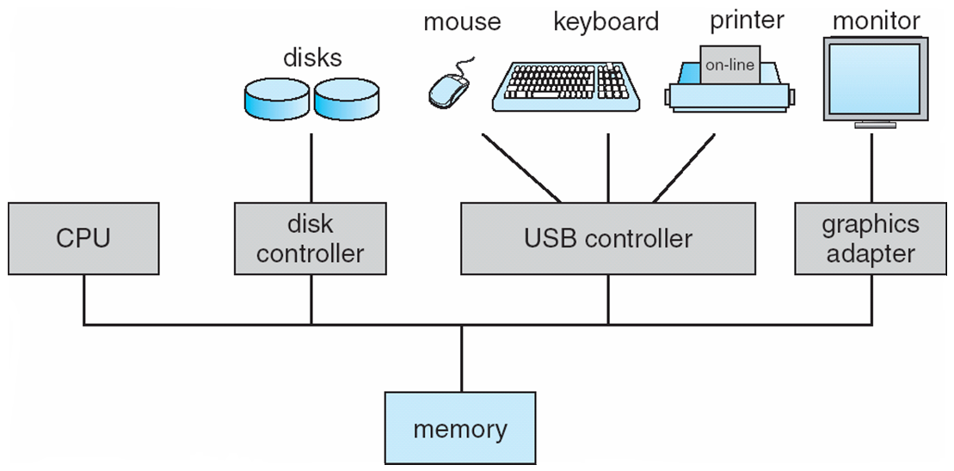
How complex is the OS’s job?
Let’s look at one of the resources managed by the OS: I/O devices

Slide 9
Carving up the disk
Entire disk
Partition table
Master boot record
Partition 1
Partition 2
Partition 3
Partition 4
Boot block
Super block
Free space management
Index nodes
Files & directories

Slide 10
Contiguous allocation for file blocks
Contiguous allocation requires all blocks of a file to be consecutive on disk
Problem: deleting files leaves “holes”
Similar to memory allocation issues
Compacting the disk can be a very slow procedure…
A
B
C
D
E
F
A
Free
C
Free
E
F

Slide 11
Contiguous allocation
Data in each file is stored in consecutive blocks on disk
Simple & efficient indexing
Starting location (block #) on disk (start)
Length of the file in blocks (length)
Random access well-supported
Difficult to grow files
Must pre-allocate all needed space
Wasteful of storage if file isn’t using all of the space
Logical to physical mapping is easy blocknum = (pos / 1024) + start; offset_in_block = pos % 1024;
0
1
2
3
4
5
6
7
8
9
10
11
Start=5
Length=2902

Slide 12
Linked allocation
File is a linked list of disk blocks
Blocks may be scattered around the disk drive
Block contains both pointer to next block and data
Files may be as long as needed
New blocks are allocated as needed
Linked into list of blocks in file
Removed from list (bitmap) of free blocks
0
1
2
3
4
6
4
5
6
7
x
x
8
9
10
11
0
Start=9
End=4
Length=2902
Start=3
End=6
Length=1500

Slide 13
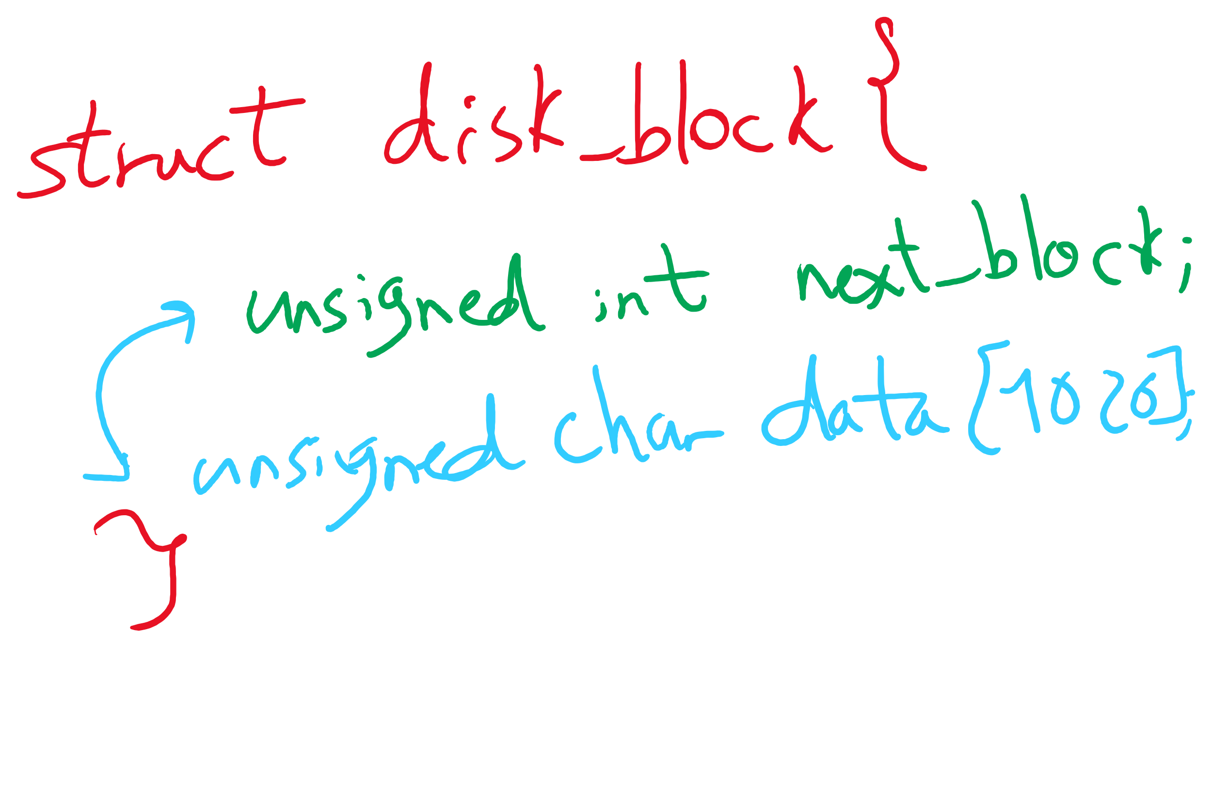
Data Structures for Linked Allocation

Slide 14
Finding blocks with linked allocation
Directory structure is simple
Starting address looked up from directory
Directory only keeps track of first block (not others)
No wasted blocks - all blocks can be used
Random access is difficult: must always start at first block!
Logical to physical mapping is done by block = start; offset_in_block = pos % 1020; for (j = 0; j < pos / 1020; j++) { block = block->next; }
Assumes that next pointer is stored at end of block
May require a long time for seek to random location in file

Slide 15
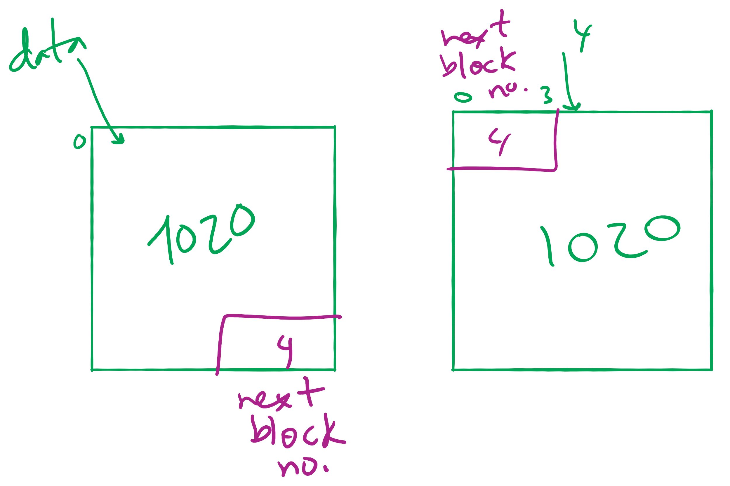
Offset Calculation

Slide 16
File Allocation Table (FAT)
Links on disk are slow
Keep linked list in memory
Advantage: faster
Disadvantages
Have to copy it to disk at some point
Have to keep in-memory and on-disk copy consistent
0
4
1
-1
2
-1
3
-2
4
-2
5
-1
6
3
B
7
-1
8
-1
9
0
A
10
-1
11
-1
12
-1
13
-1
14
-1
15
-1

Slide 17
Problem of the Day
How to allocate disk blocks to files and directories?

Slide 18
File Allocation Table (FAT)
Links on disk are slow
Keep linked list in memory
Advantage: faster
Disadvantages
Have to copy it to disk at some point
Have to keep in-memory and on-disk copy consistent
0
4
1
-1
2
-1
3
-2
4
-2
5
-1
6
3
B
7
-1
8
-1
9
0
A
10
-1
11
-1
12
-1
13
-1
14
-1
15
-1

Slide 19
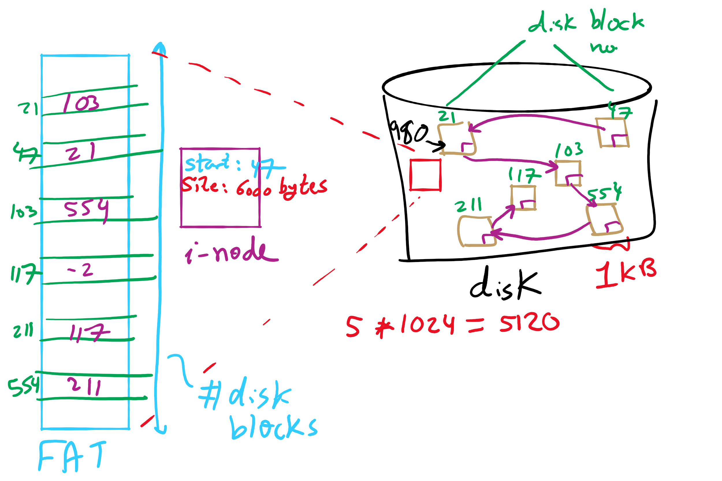
FAT Example

Slide 20
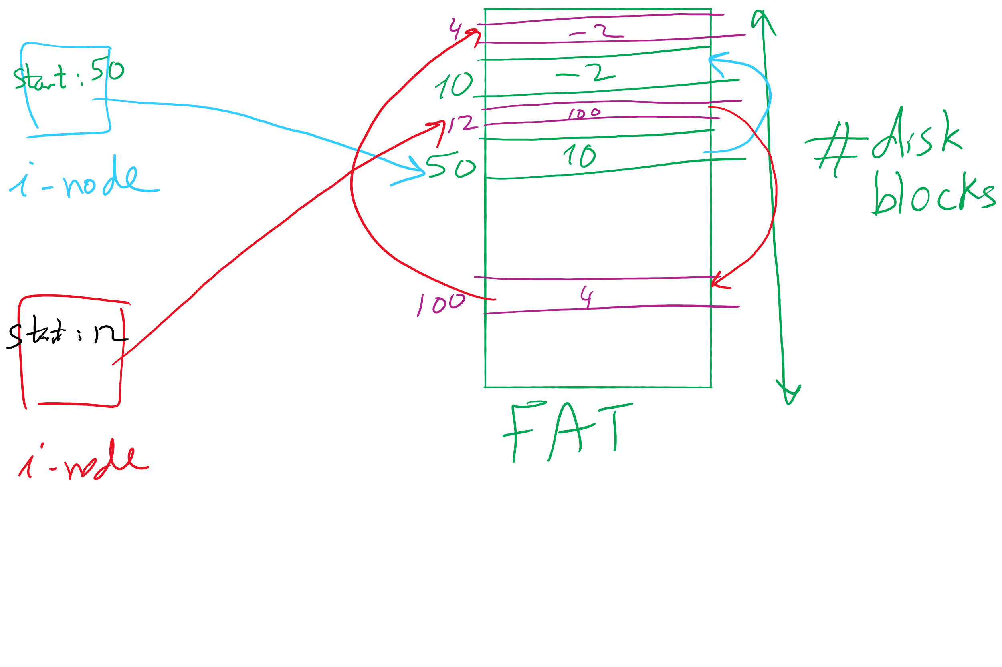
i-node and FAT

Slide 21
Using a block index for allocation
Store file block addresses in an array
Array itself is stored in a disk block
Directory has a pointer to this disk block
Non-existent blocks indicated by -1
Random access easy
Limit on file size?
Name index size
grades 4 4802
0
1
2
3
6
9
7
0
8
4
5
6
7
8
9
10
11

Slide 22
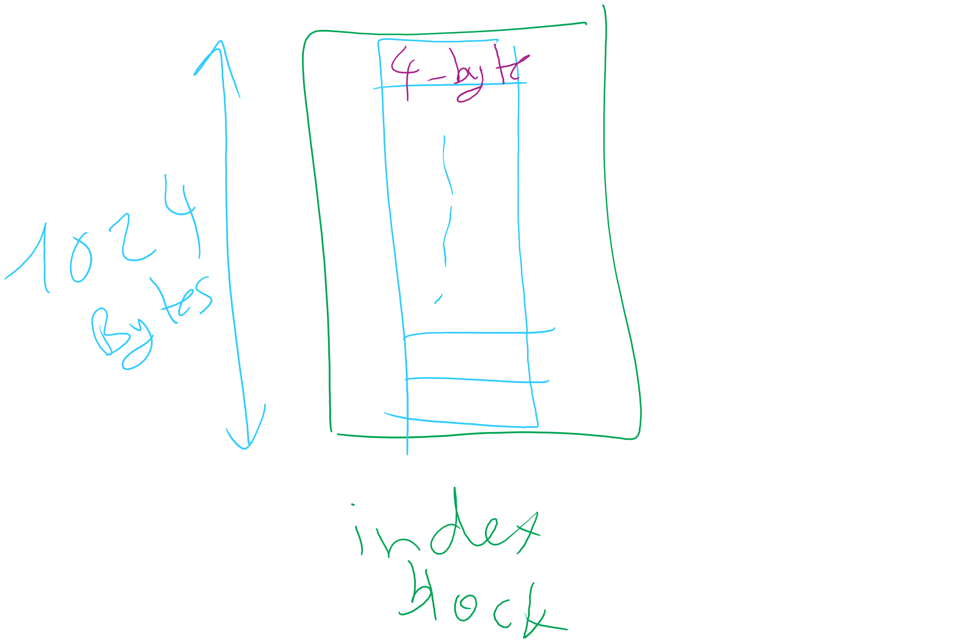
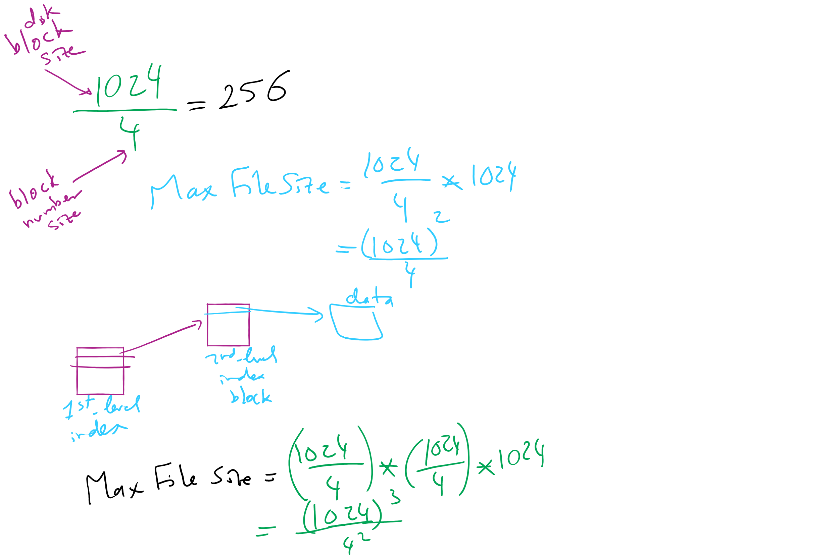
Max File Size for Indexed Allocation

Slide 23
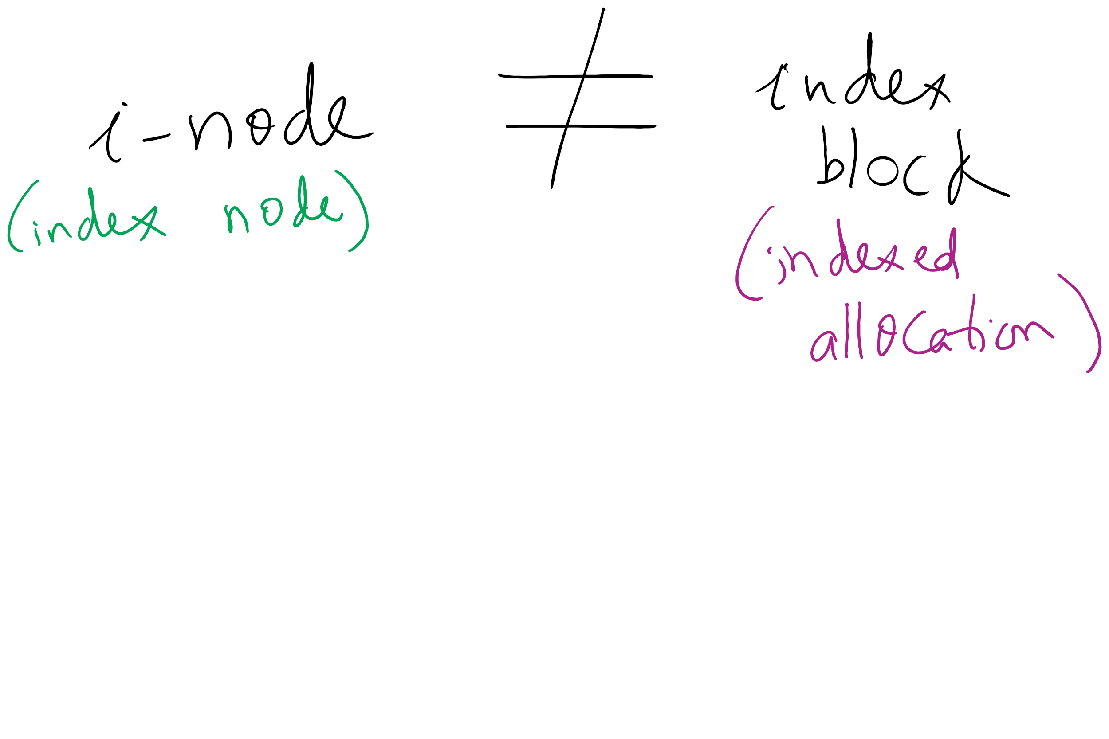
i-node vs index block

Slide 24
Unix Fast File System indexing scheme
protection mode
data
owner & group
data
.
.
.
timestamps
size
data
block count
•
data
•
.
.
.
link count
•
Direct pointers
.
.
.
data
•
•
•
data
•
.
.
.
•
•
single indirect
•
•
data
double indirect
•
•
data
•
•
•
•
.
.
.
triple indirect
•
•
•
inode
•
•
•
data

Slide 25
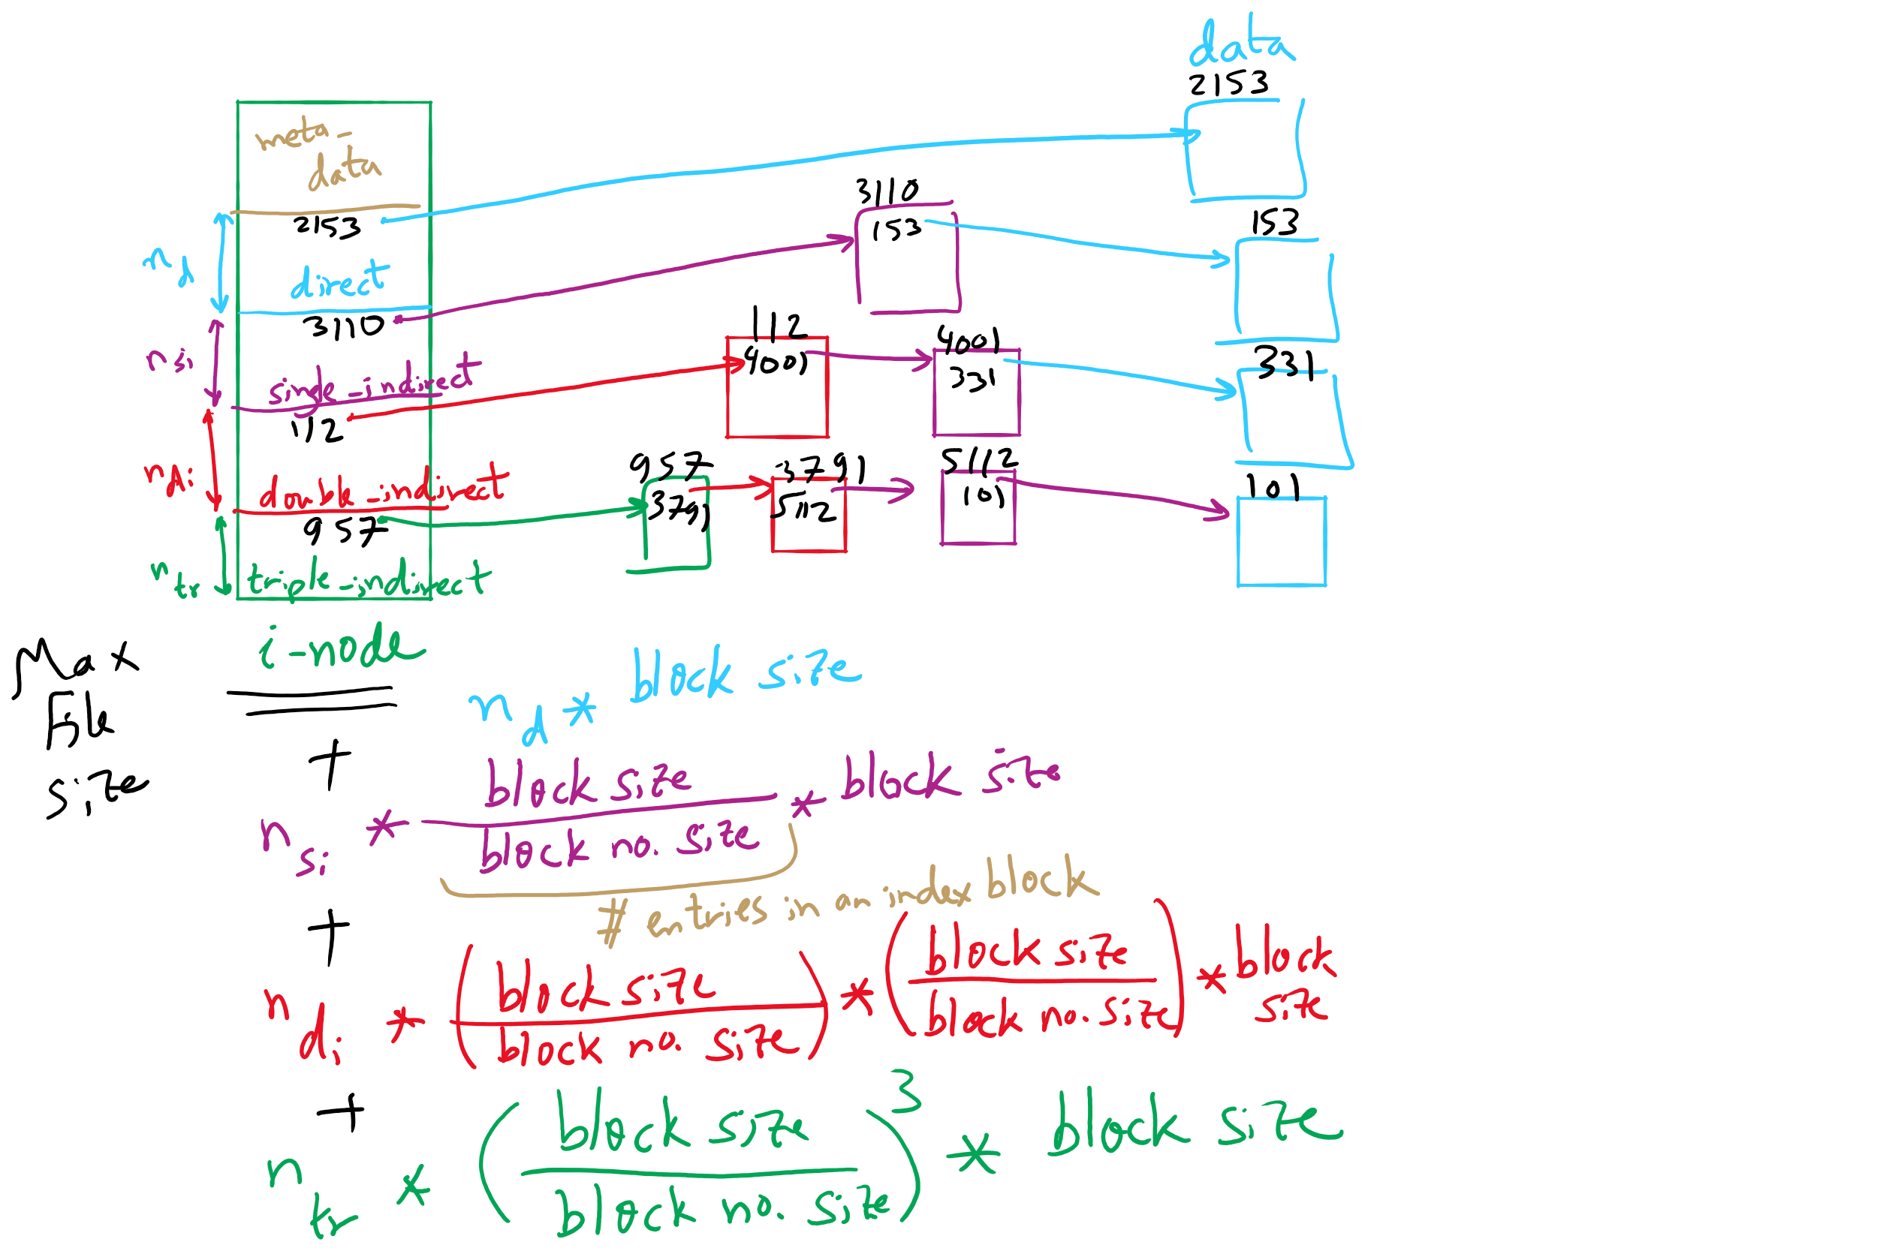
FFS and Max File Size

Slide 26
What’s in a directory?
Two types of information
File names
File metadata (size, timestamps, etc.)
Basic choices for directory information
Store all information in directory
Fixed size entries
Disk addresses and attributes in directory entry
Store names & pointers to index nodes (i-nodes)
attributes
games
attributes
games
mail
attributes
mail
attributes
news
attributes
news
attributes
research
attributes
research
Storing all information in the directory
Using pointers to index nodes
attributes

Slide 27
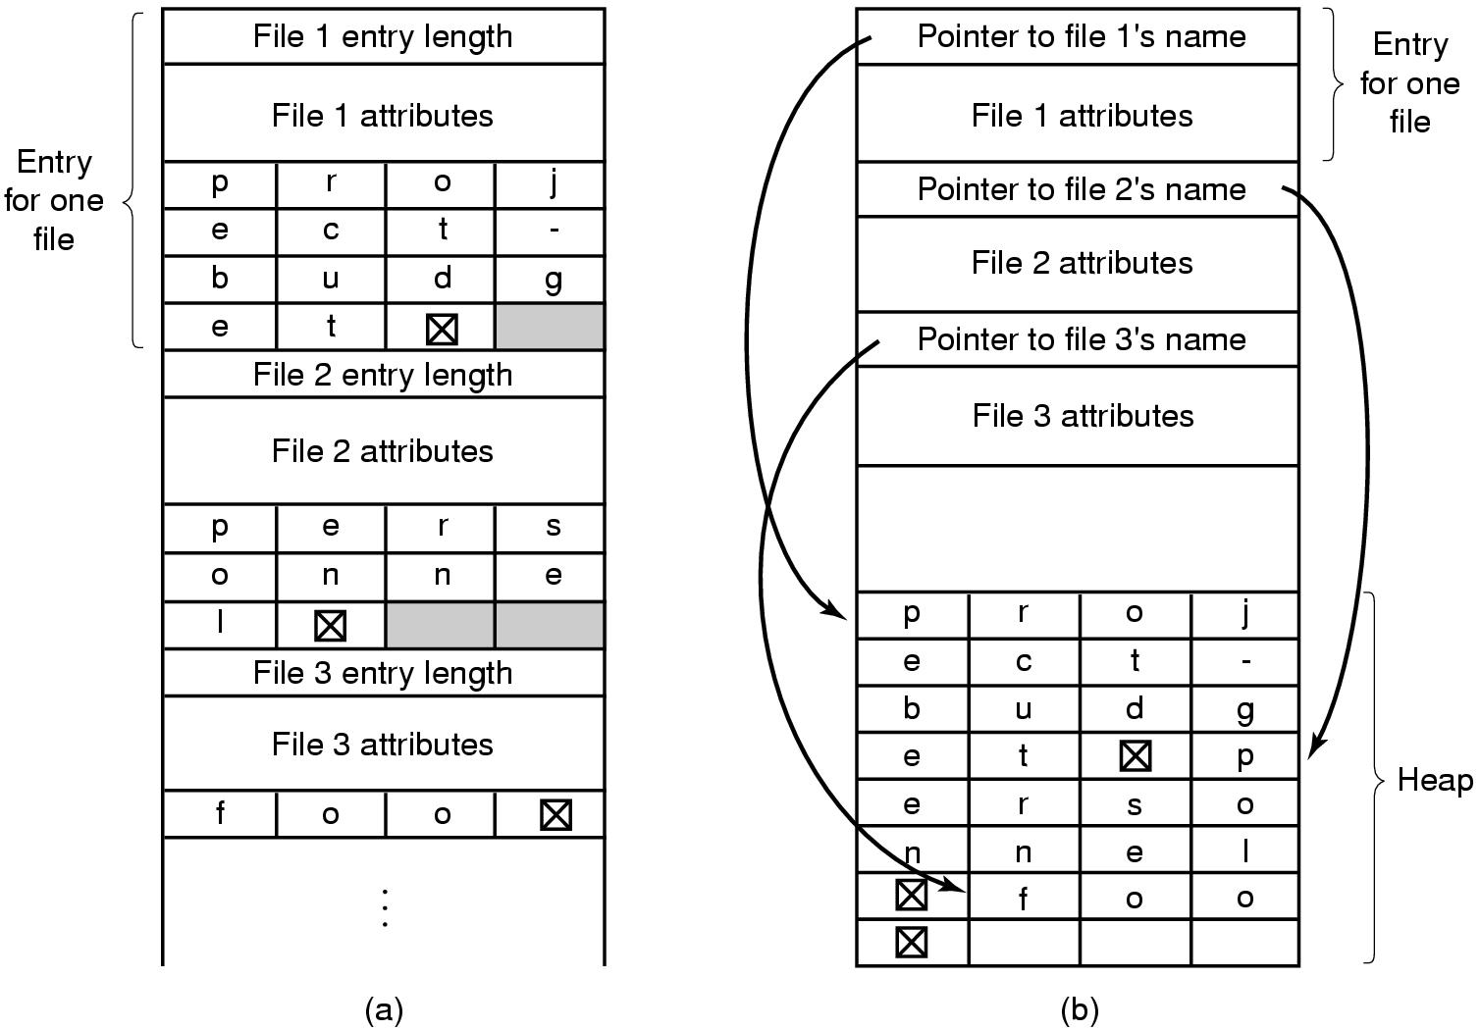
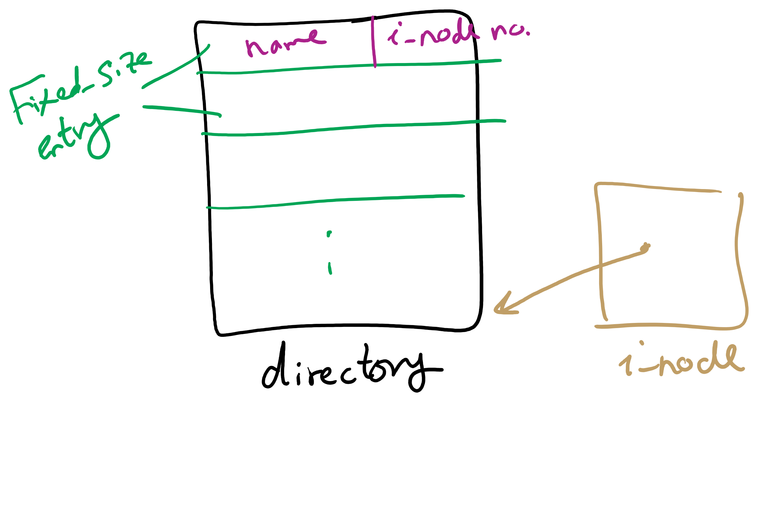
Handling long file names in a directory

Slide 28
Free Block Tracking
10

Slide 29
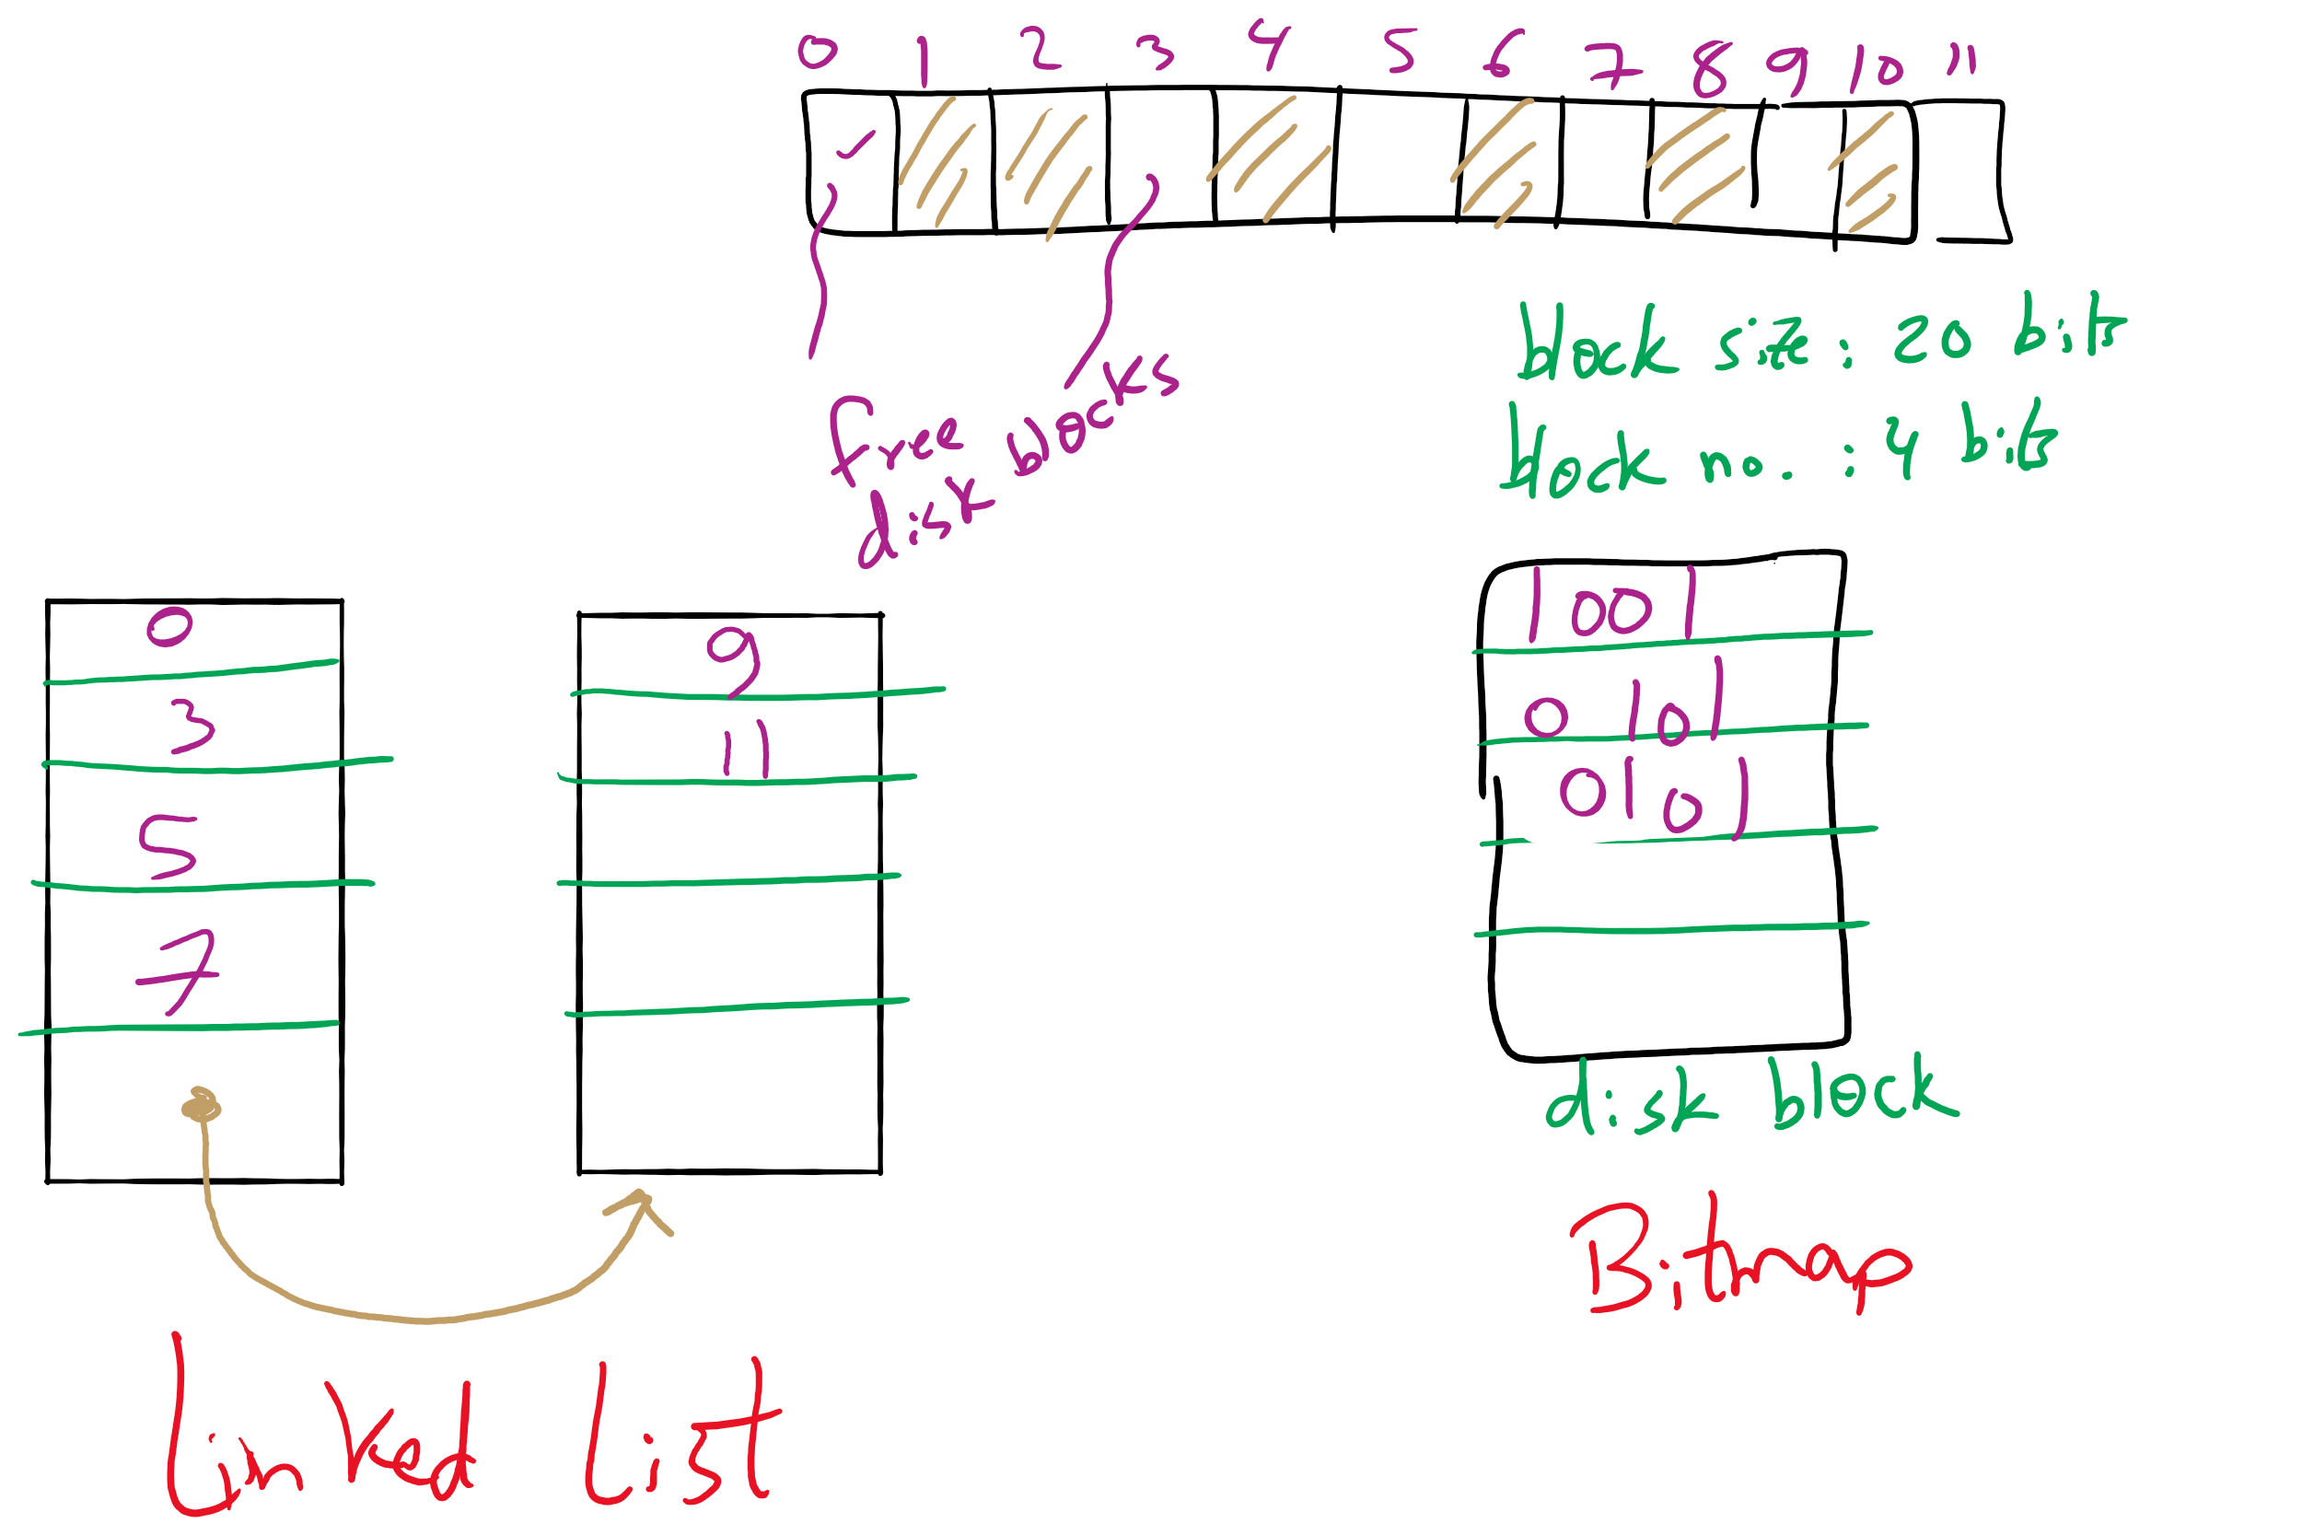
Free Block Tracking Example 1

Slide 30
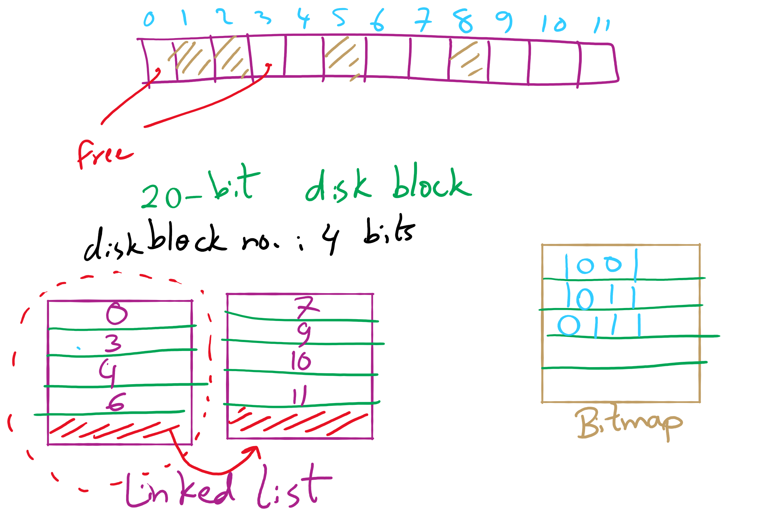
Free Block Tracking Example 2

